Slide 1
SKINALYZER: AI-BASED SKIN CANCER DETECTION SYSTEM
MELİKE HAZAL ÖZCAN 202011013
BEKİR EMREHAN ŞİMŞEK 202011039
PELİN KOZ 202011048
BİLGESU FINDIK 202011407
Advisor: DR. Ayşe Nurdan SARAN

Slide 2
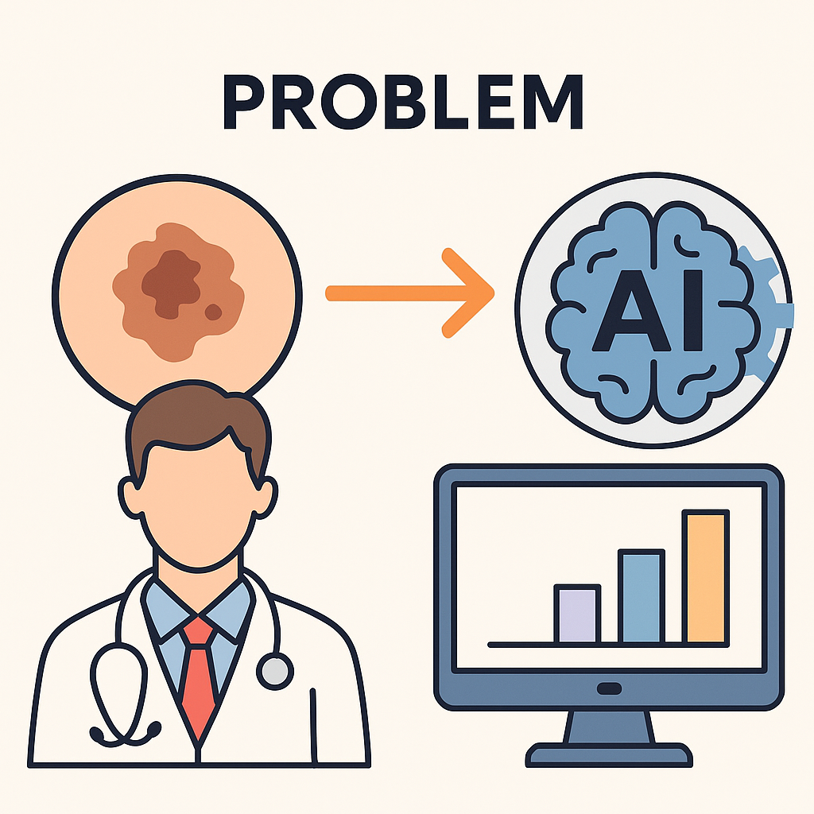
Problem Definition
Skin cancer poses a life-threatening risk if not diagnosed early. The lack of experts, data privacy issues, and the inability of existing systems to process new data increase the need for automated and reliable diagnostic systems. Skinalyzer aims to solve these problems with Federated Learning and Incremental Learning.

Slide 3
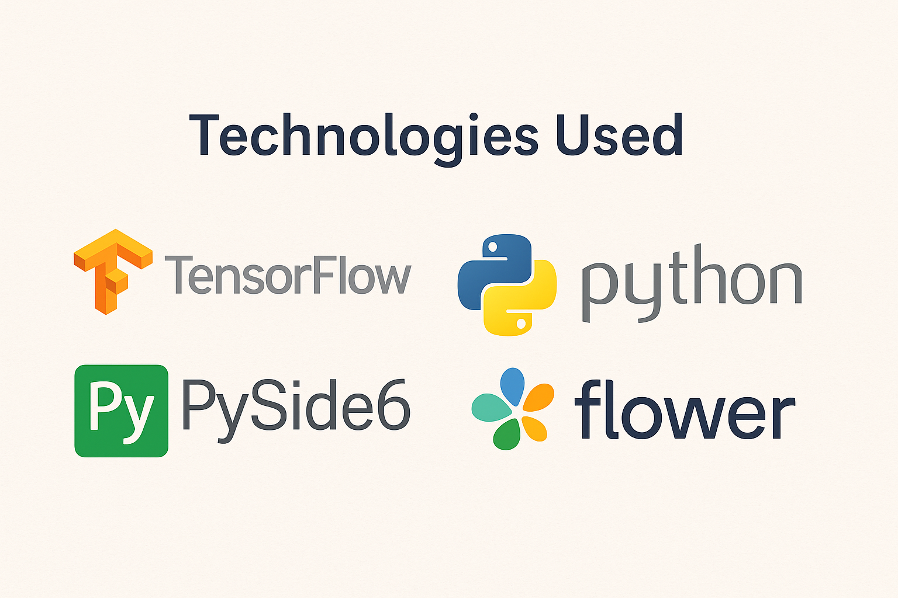
Technologies Used
Python
TensorFlow / Keras
Flower (FL Framework)
Pyside6
MySQL
HAM10000 & ISIC2019

Slide 4
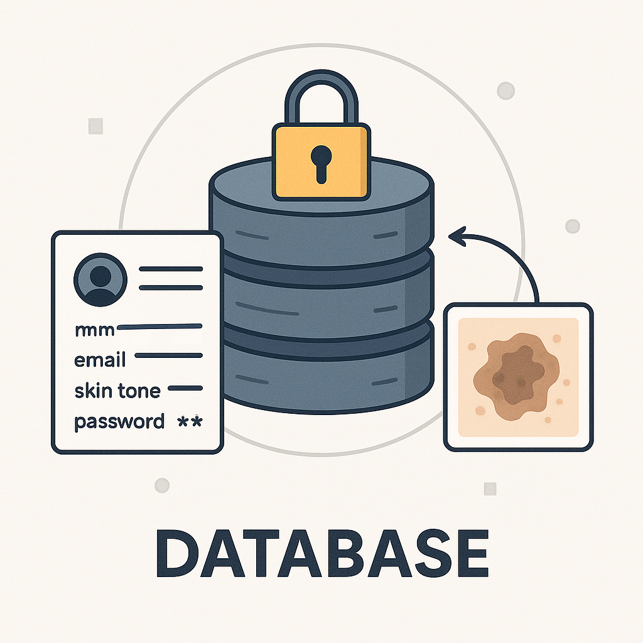
Database
The database is designed to securely store user information (name, email, skin tone, password) and analysis results. After registering and logging in, users upload skin lesion images and the analysis results are saved specifically for the user. This structure provides the infrastructure for system personalization and future incremental learning processes.

Slide 5
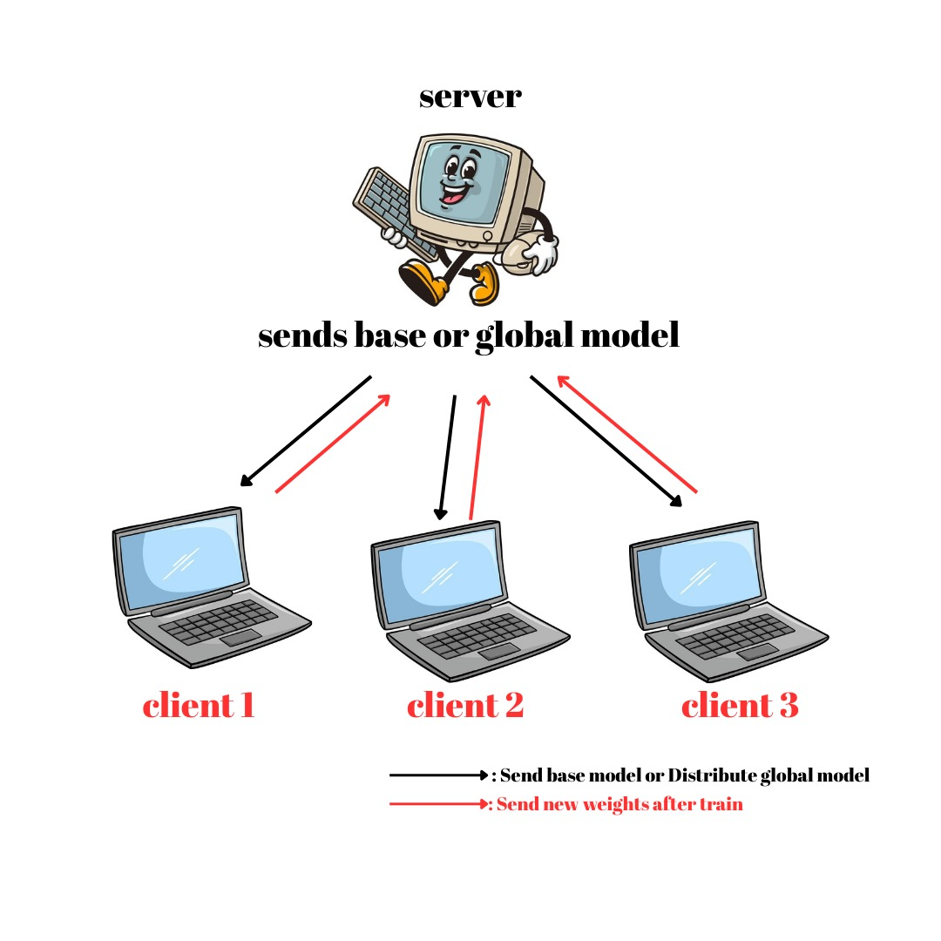
Federated Learning
✅ Decentralized model training
✅ Data stays on the device, only weights are shared
✅ Privacy and regulatory advantage
🌟We used the HAM10000 dataset, split into 3 parts, one for each client. Handles training rounds: clients train locally, send weights, and receive updated global model.

Slide 6

Server–Client Communication via Flower Framework
We built an efficient and privacy-focused federated learning system using the Flower framework, which enabled direct server–client communication via gRPC without the need for Kafka, and seamlessly integrated with our Python and TensorFlow-based deep learning setup.

Slide 7
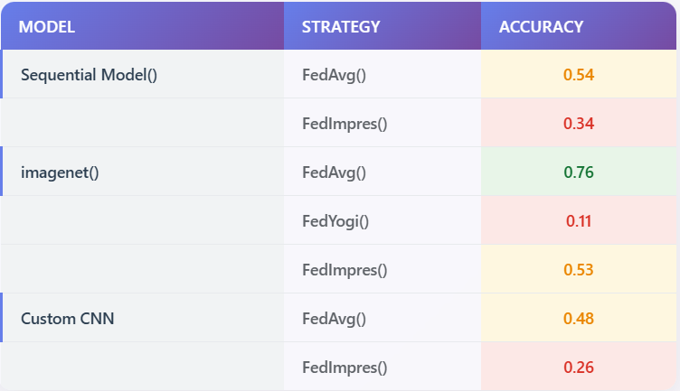
Federated Learning Strategies
The ImageNet-based model achieved the best performance, and the most effective federated learning strategy supporting this model was FedAvg.

Slide 8
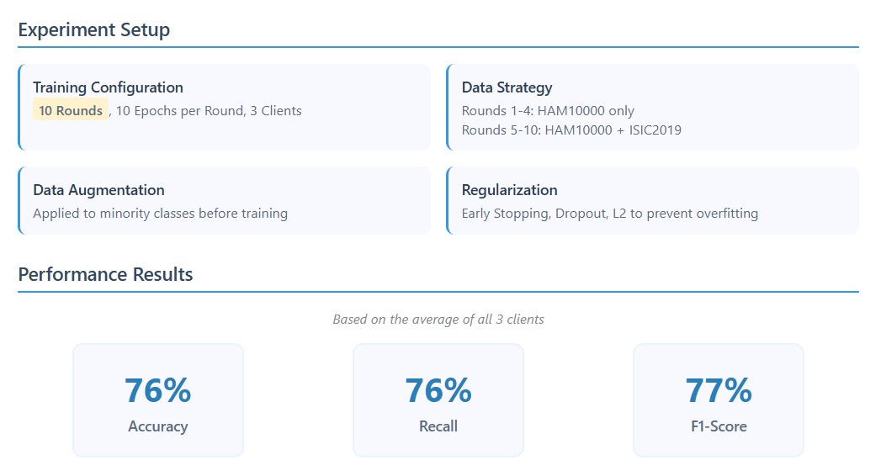
Federated Learning’s Final Results

Slide 9
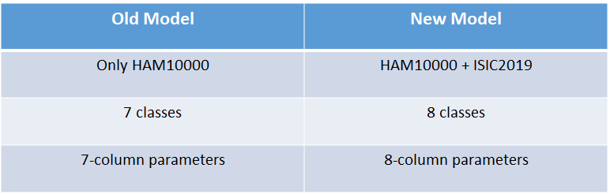
Incremental Learning
HAM10000 Classes: Actinic Keratoses & Intraepithelial Carcinoma (AKIEC), Basal Cell Carcinoma, Benign Keratosis-Like Lesions, Dermatofibroma, Melanoma, Melanocytic Nevi, Vascular Lesions
ISIC 2019 Classes: Actinic Keratoses & Intraepithelial Carcinoma (AKIEC), Basal Cell Carcinoma, Benign Keratosis-Like Lesions, Dermatofibroma, Melanoma, Melanocytic Nevi, Vascular Lesions, Squamous Cell Carcinoma

Slide 10
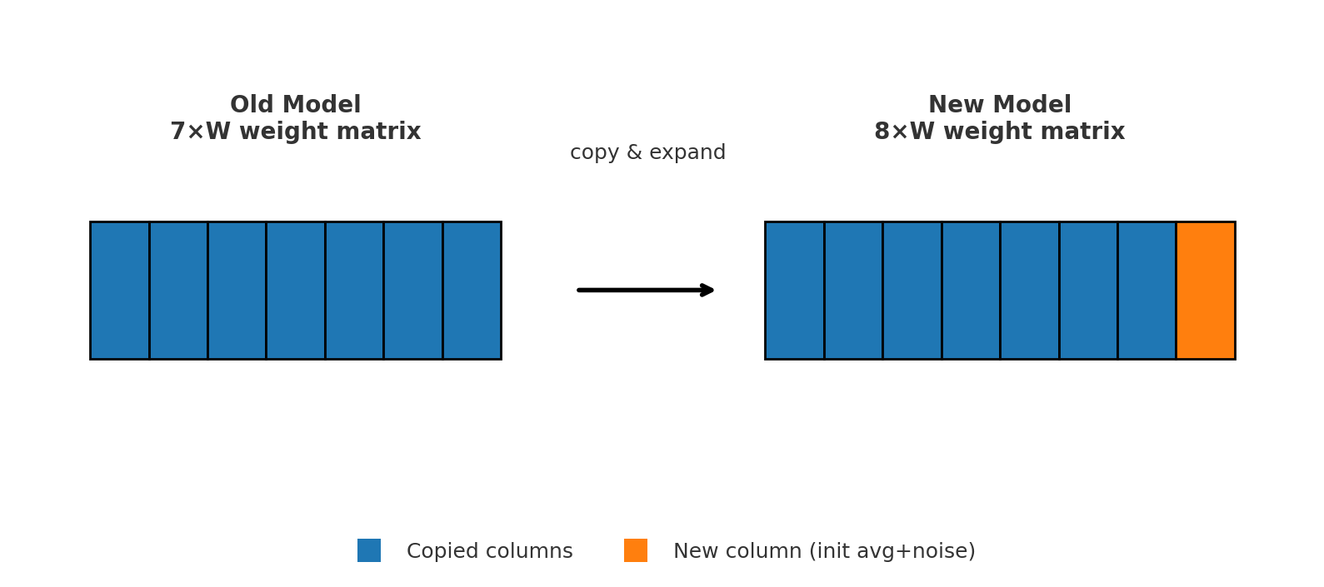
Expanding our Model
The first 7 columns were copied exactly as they were from the old model.
In the last column, the old weights are averaged and the small noise is added
Prevention against Catastrophic Forgetting, i.e. forgetting old information

Slide 11
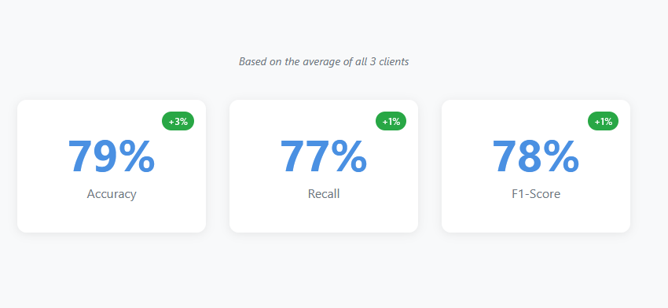
Incremental Learning Model Performance
Overall performance of the model improved with no catastrophic forgetting effect
But the model did not perform very well in predicting the SCC class, so fine tuning was required

Slide 12
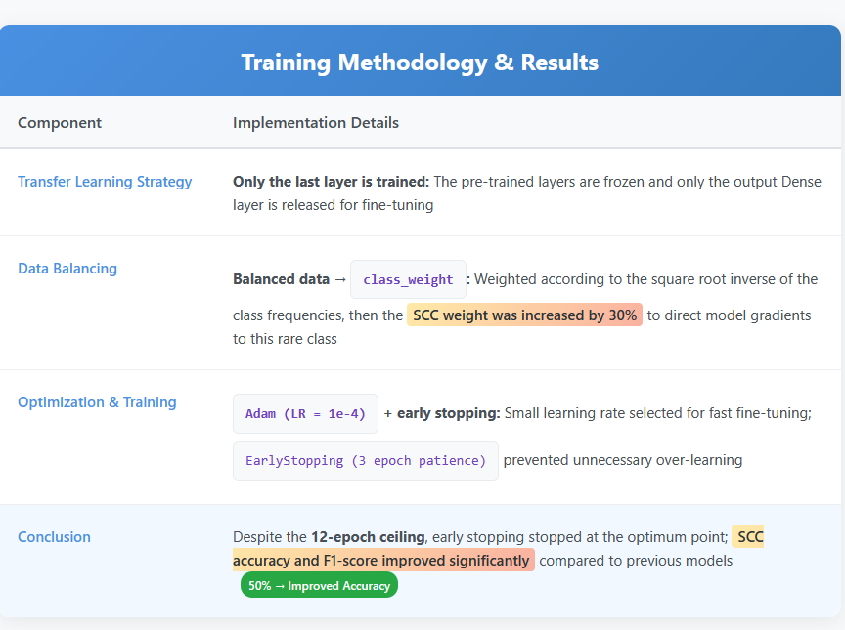
Fine-tune the model for better learning of the new class

Slide 13


User Interface
Desktop application built with PySide6
Simple, secure, and user-friendly design
Used to upload images and view skin analysis

Slide 14
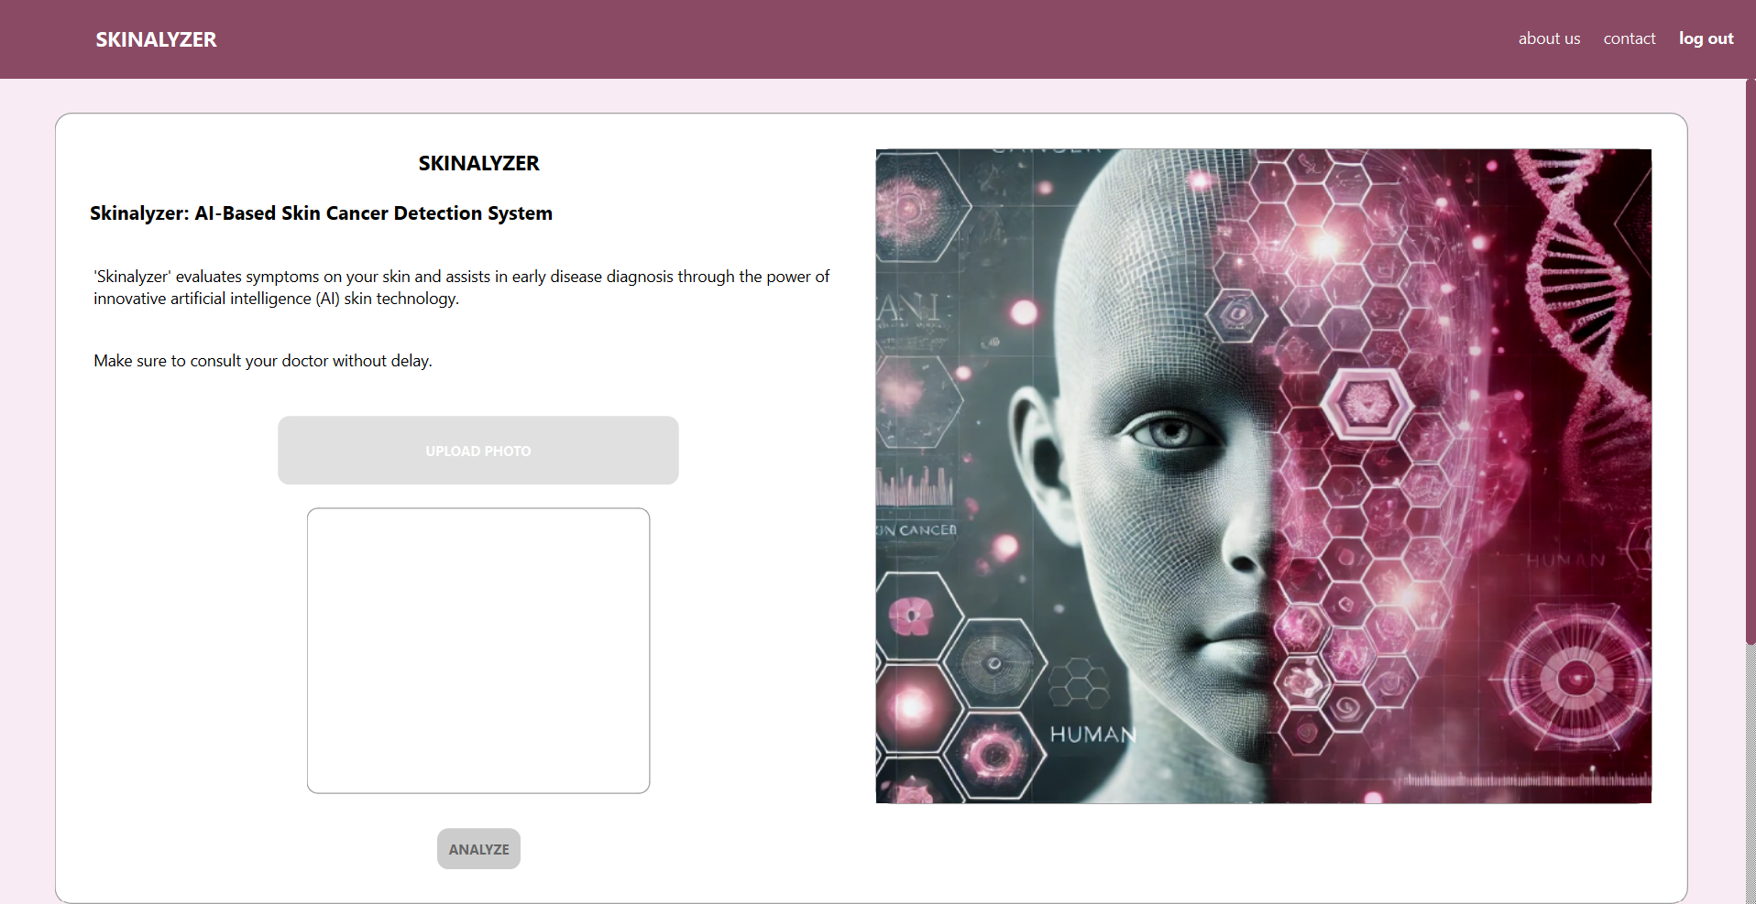
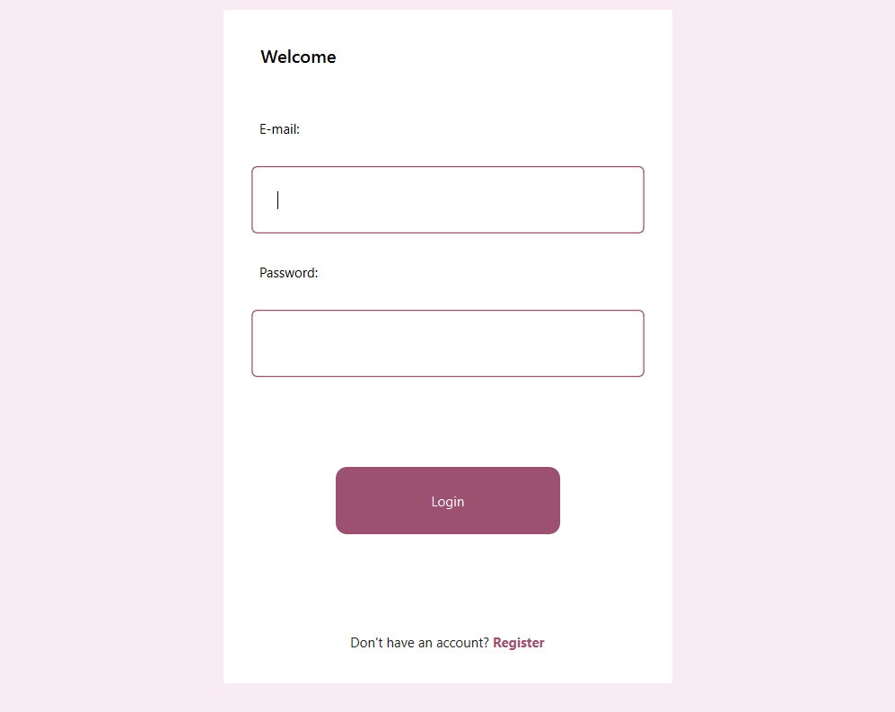
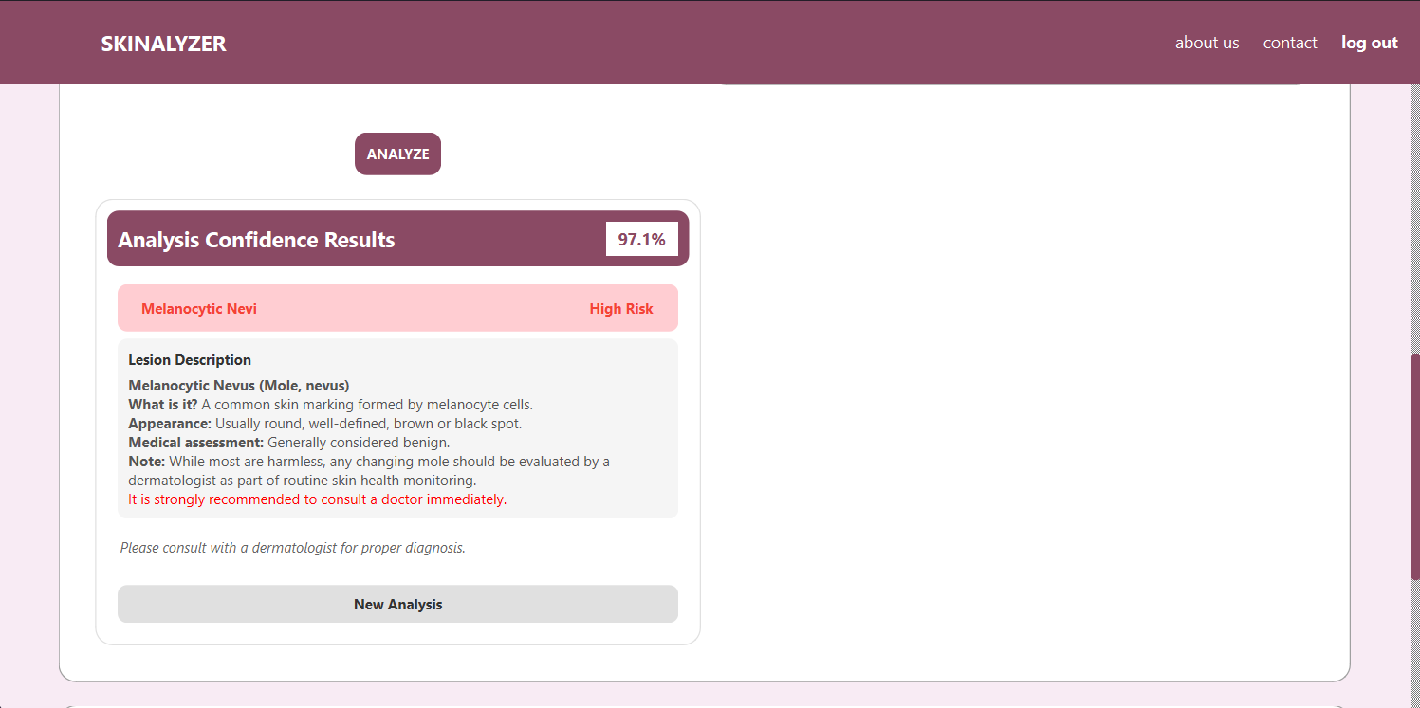
Login Screen
Upload Screen
Result Screen (with color-coded output)

Slide 15
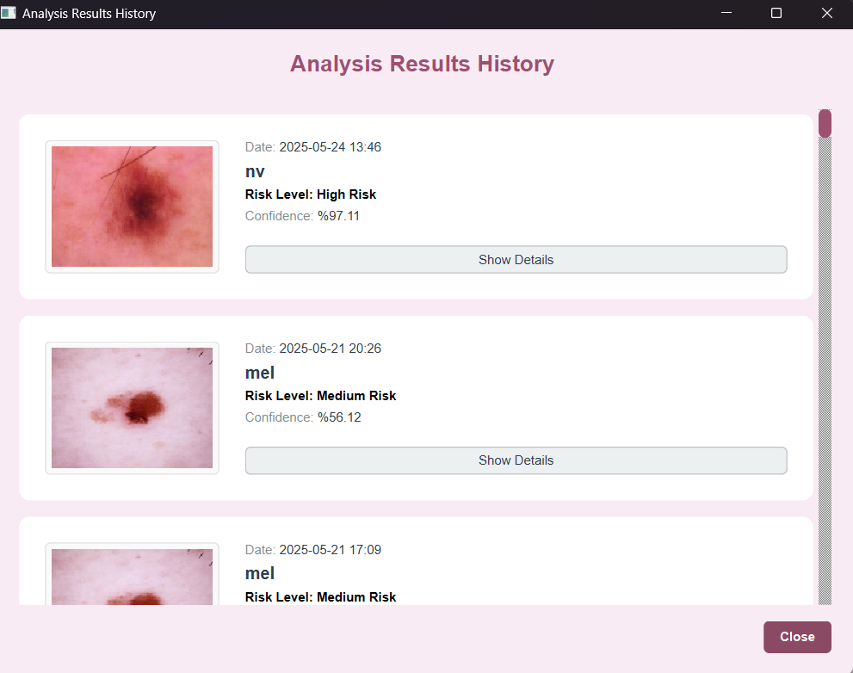
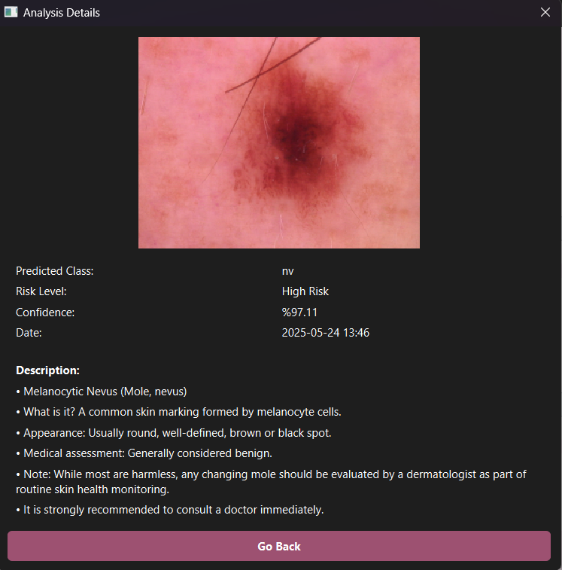
Simple and understandable flow: Record → Load → Analysis → Result
Past analysis
Guiding the user with back buttons and error messages
Minimal interface for quick navigation

Slide 16
Thank you for listening!

